Slide 1
St. Louis Central Corridor West Building Permits
Quarter 4 Report: 2020

Slide 2
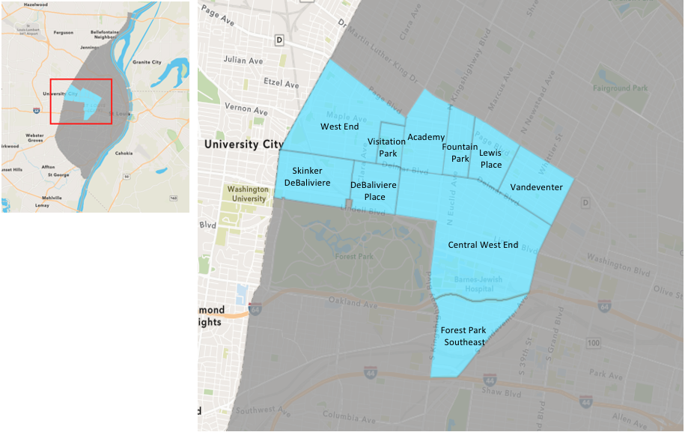
St. Louis Neighborhood Spatial Reference

Slide 3
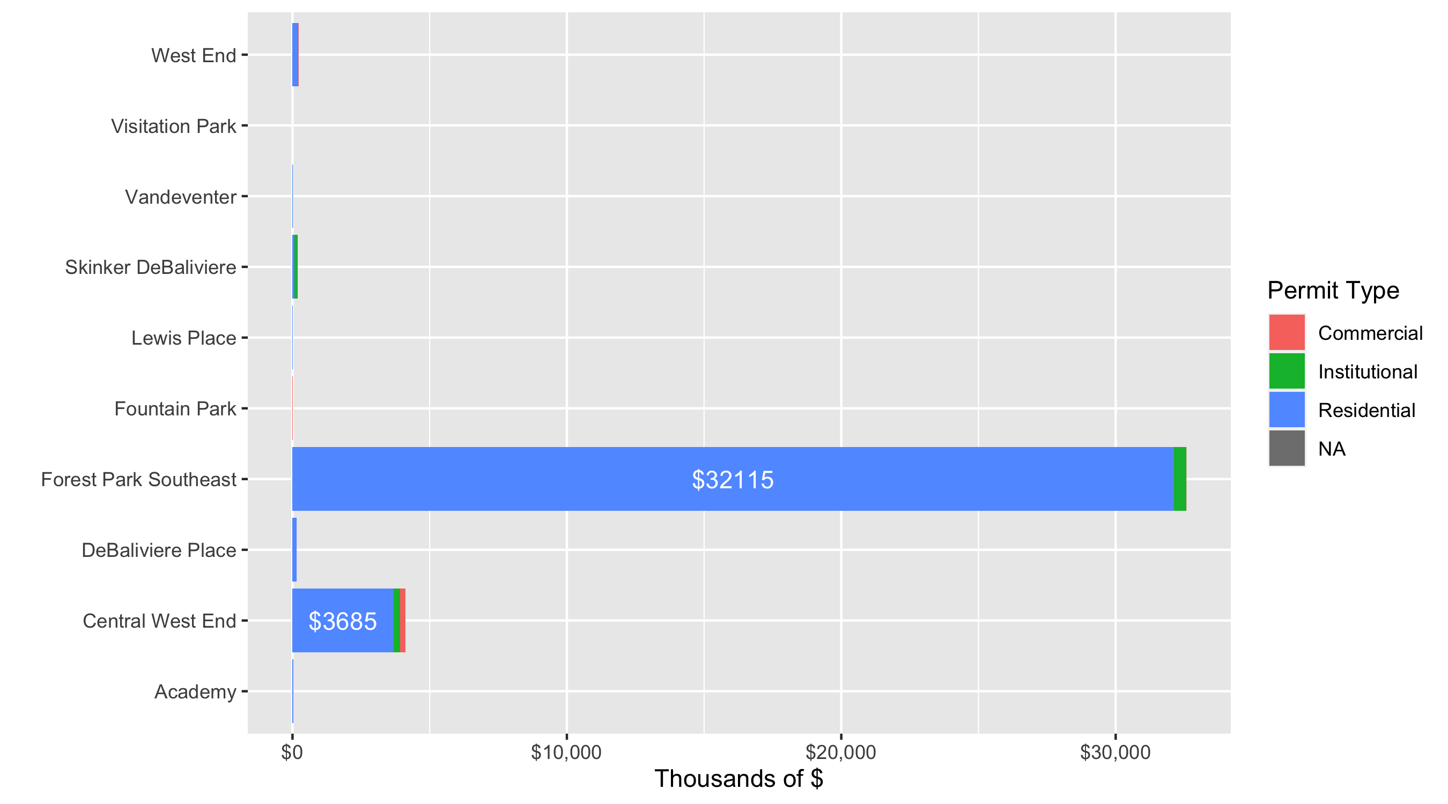
Neighborhood Summary: Total Building Permit Cost

Slide 4
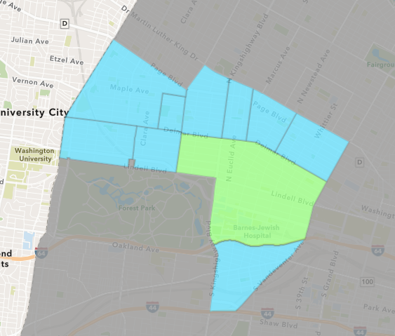
Central West End
Quarter 4 , 2020 Neighborhood Cost Breakdown
Sum of Permits: $7,095,032
Mean: $69,559
Median: $14,500
Range: $500 - $800,000

Slide 5
Central West End: Summary Notes
102 building permits in Quarter 4, 2020
-24.44% change compared to Quarter 4, 2019 (135 total building permits)
$69,559: Average building permit cost in Quarter 4, 2020
-79.55% change compared to Quarter 4, 2019 ($340,108)

Slide 6
Central West End: Summary Notes
57 residential permits in Quarter 4, 2020
9.62% change compared to Quarter 4, 2019 (52 total building permits)
$646,427: Average residential building permit cost in Quarter 4, 2020
2284.40% change compared to Quarter 4, 2019 ($27,111)
0 industrial permits in Quarter 4, 2020
0.00% change compared to Quarter 4, 2019 (0 total building permits)
$0: Average industrial building permit cost in Quarter 4, 2020
0.00% change compared to Quarter 4, 2019 ($0)

Slide 7
Central West End: Summary Notes
16 commercial permits in Quarter 4, 2020
-5.88% change compared to Quarter 4, 2019 (17 total building permits)
$116,544: Average commercial building permit cost in Quarter 4, 2020
-93.60% change compared to Quarter 4, 2019 ($1,820,422)
32 residential permits in Quarter 4, 2020
-51.52% change compared to Quarter 4, 2019 (66 total building permits)
$75,124: Average institutional building permit cost in Quarter 4, 2020
-63.43% change compared to Quarter 4, 2019 ($0)

Slide 8
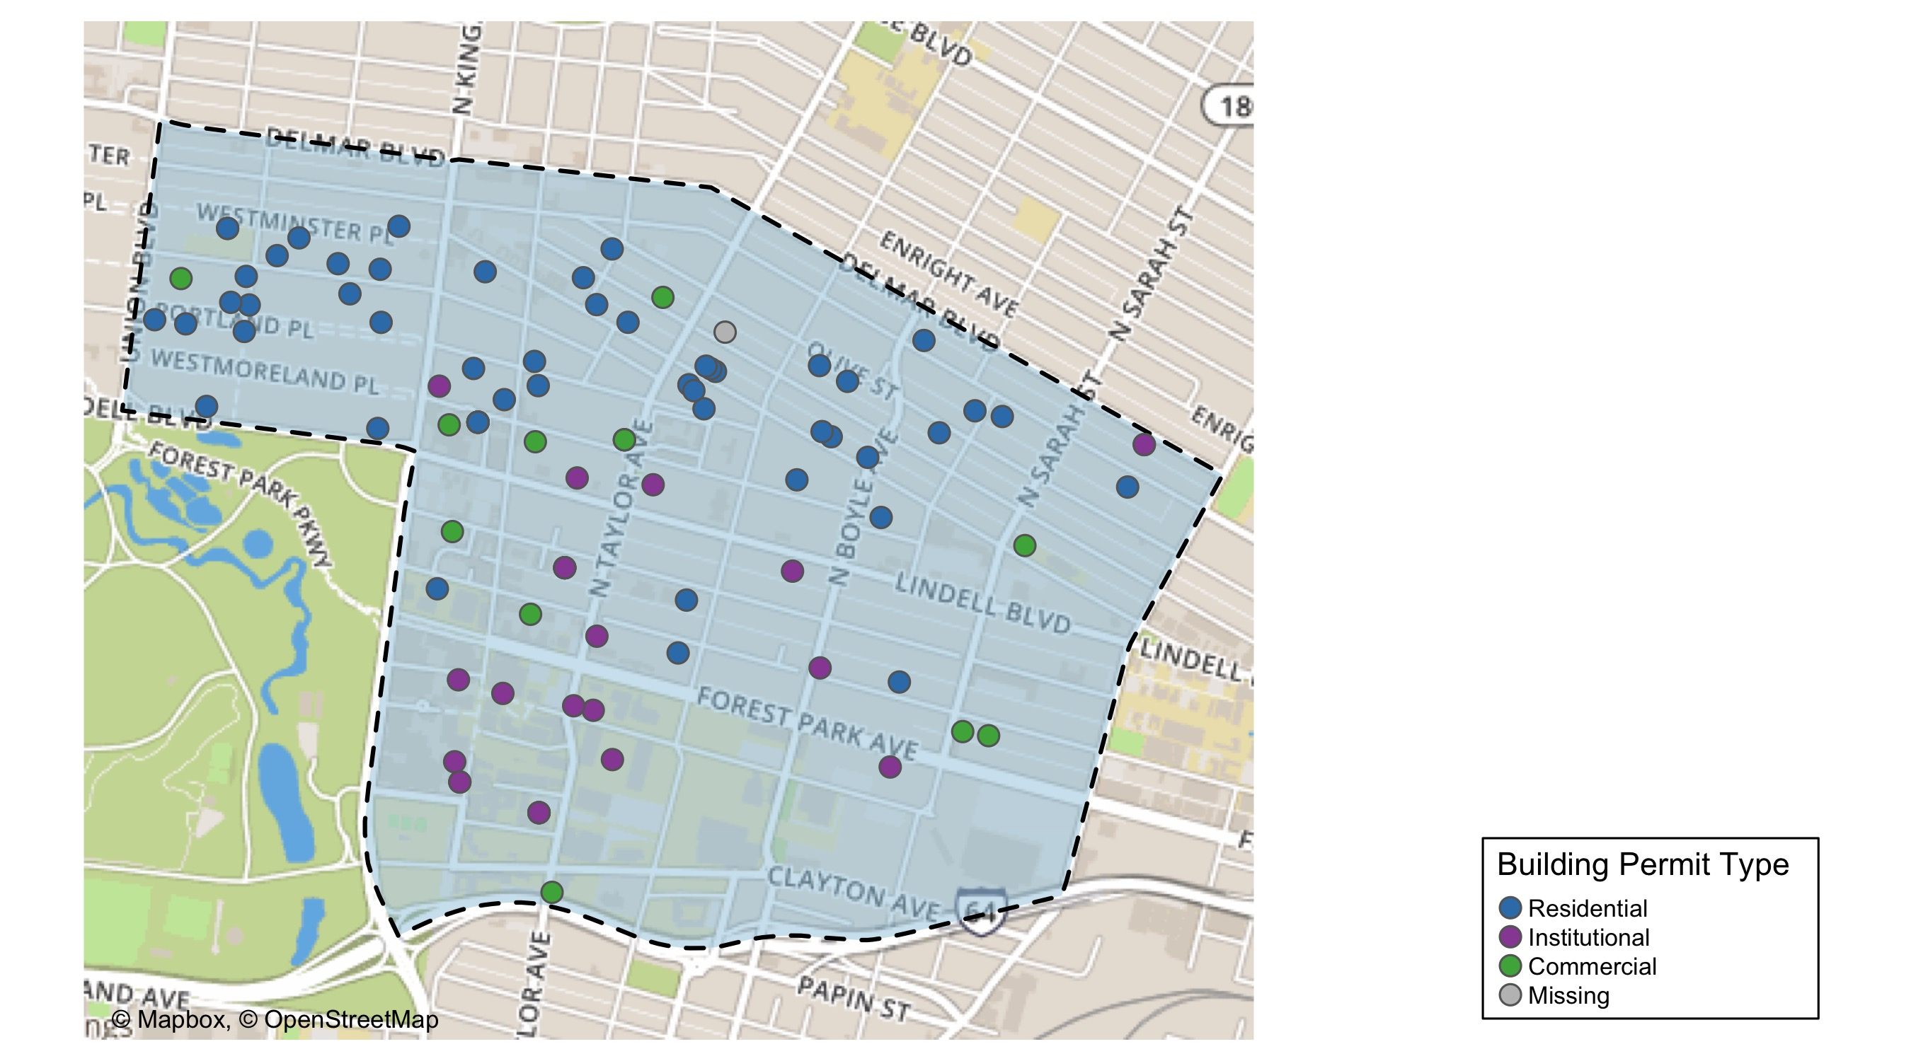
Central West End

Slide 9
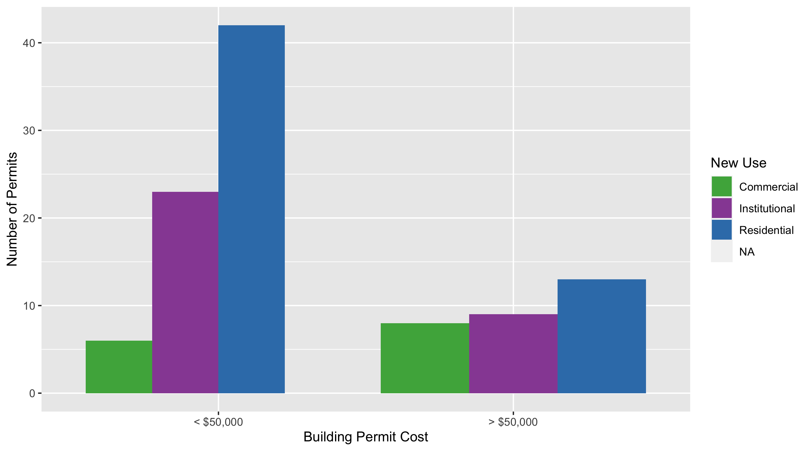
Central West End Permit Use Breakdown

Slide 10
Central West End Permit Breakdown
Quarter 4, 2020 | Quarter 4, 2020 | Quarter 4, 2020 | Quarter 4, 2020
Permit Use | Average Cost | # of Permits | Total Value of Permits
0 | 4e+03 | 1 | 4e+03
Commercial | 1e+05 | 14 | 2e+06
Industrial | 0e+00 | 0 | 0e+00
Institutional | 8e+04 | 32 | 2e+06
Residential | 5e+04 | 55 | 3e+06
Total | 3e+05 | 102 | 7e+06
Quarter 4, 2019 | Quarter 4, 2019 | Quarter 4, 2019 | Quarter 4, 2019
Permit Use | Average Cost | # of Permits | Total Value of Permits
Commercial | 2e+06 | 17 | 3e+07
Industrial | 0e+00 | 0 | 0e+00
Institutional | 2e+05 | 66 | 1e+07
Residential | 3e+04 | 52 | 1e+06
Total | 2e+06 | 135 | 5e+07

Slide 11
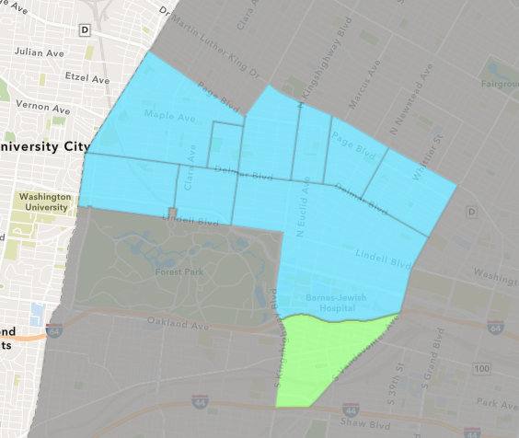
Forest Park Southeast
Quarter 4 , 2020 Neighborhood Cost Breakdown
Sum of Permits: $24,920,462
Mean: $922,980
Median: $10,000
Range: $1,500 - $4,500,000

Slide 12
Forest Park Southeast: Summary Notes
27 building permits in Quarter 4, 2020
-28.95% change compared to Quarter 4, 2019 (38 total building permits)
$922,980: Average building permit cost in Quarter 4, 2020
319.20% change compared to Quarter 4, 2019 ($220,175)

Slide 13
Forest Park Southeast: Summary Notes
21 residential permits in Quarter 4, 2020
-16.00% change compared to Quarter 4, 2019 (25 total building permits)
$15,292,672: Average residential building permit cost in Quarter 4, 2020
13188.50% change compared to Quarter 4, 2019 ($115,082)
0 industrial permits in Quarter 4, 2020
0.00% change compared to Quarter 4, 2019 (0 total building permits)
$0: Average industrial building permit cost in Quarter 4, 2020
0.00% change compared to Quarter 4, 2019 ($0)

Slide 14
Forest Park Southeast: Summary Notes
4 commercial permits in Quarter 4, 2020
-50.00% change compared to Quarter 4, 2019 (8 total building permits)
$18,500: Average commercial building permit cost in Quarter 4, 2020
-56.35% change compared to Quarter 4, 2019 ($42,381)
5 residential permits in Quarter 4, 2020
0.00% change compared to Quarter 4, 2019 (5 total building permits)
$907,100: Average institutional building permit cost in Quarter 4, 2020
-11.94% change compared to Quarter 4, 2019 ($0)

Slide 15
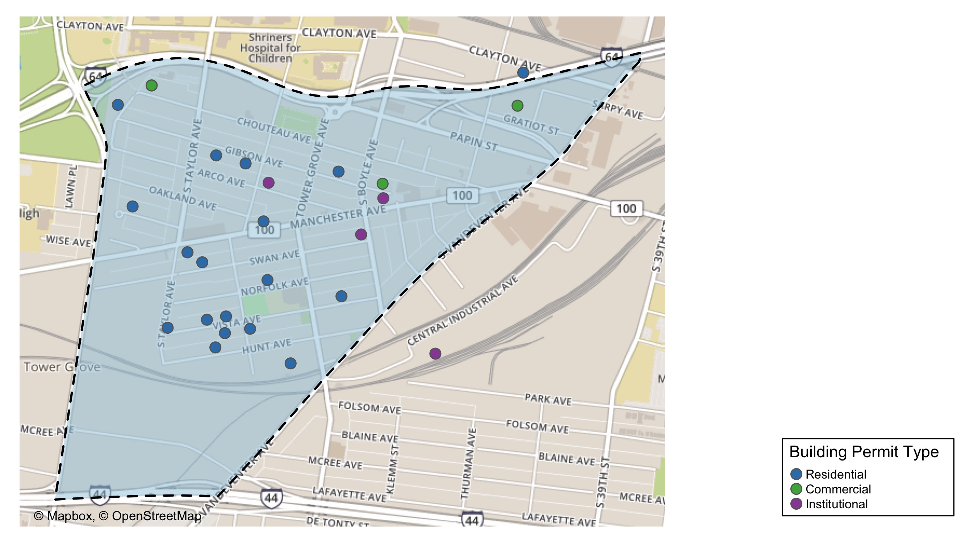
Forest Park Southeast

Slide 16
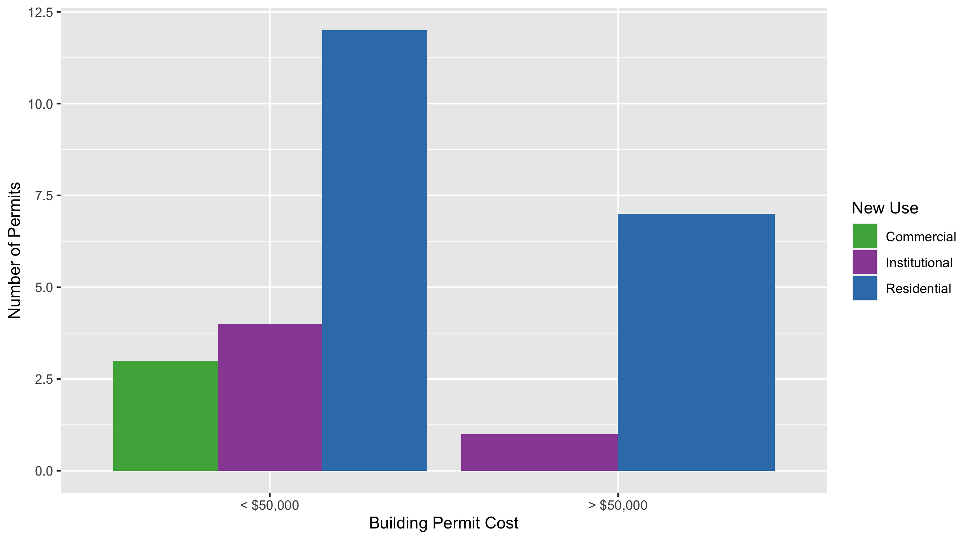
Forest Park Southeast Permit Use Breakdown

Slide 17
Forest Park Southeast Permit Breakdown
Quarter 4, 2020 | Quarter 4, 2020 | Quarter 4, 2020 | Quarter 4, 2020
Permit Use | Average Cost | # of Permits | Total Value of Permits
Commercial | 1e+04 | 3 | 4e+04
Industrial | 0e+00 | 0 | 0e+00
Institutional | 9e+05 | 5 | 5e+06
Residential | 1e+06 | 19 | 2e+07
Total | 2e+06 | 27 | 2e+07
Quarter 4, 2019 | Quarter 4, 2019 | Quarter 4, 2019 | Quarter 4, 2019
Permit Use | Average Cost | # of Permits | Total Value of Permits
Commercial | 4e+04 | 8 | 3e+05
Industrial | 0e+00 | 0 | 0e+00
Institutional | 1e+06 | 5 | 5e+06
Residential | 1e+05 | 25 | 3e+06
Total | 1e+06 | 38 | 8e+06

Slide 18
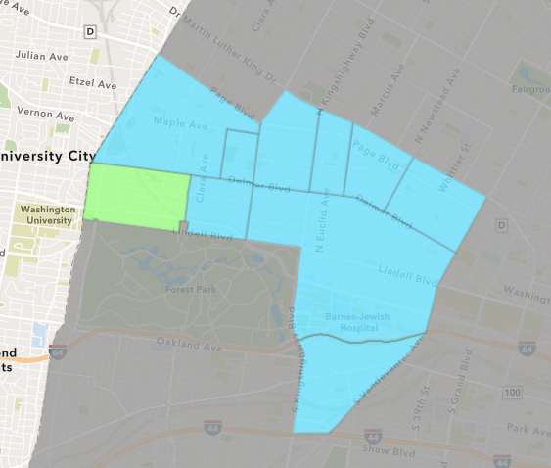
Skinker DeBaliviere
Quarter 4 , 2020 Neighborhood Cost Breakdown
Sum of Permits: $1,912,567
Mean: $73,560
Median: $20,000
Range: $800 - $1,186,000

Slide 19
Skinker DeBaliviere: Summary Notes
26 building permits in Quarter 4, 2020
8.33% change compared to Quarter 4, 2019 (24 total building permits)
$73,560: Average building permit cost in Quarter 4, 2020
287.32% change compared to Quarter 4, 2019 ($18,992)

Slide 20
Skinker DeBaliviere: Summary Notes
21 residential permits in Quarter 4, 2020
-4.55% change compared to Quarter 4, 2019 (22 total building permits)
$31,103: Average residential building permit cost in Quarter 4, 2020
62.72% change compared to Quarter 4, 2019 ($19,114)
0 industrial permits in Quarter 4, 2020
0.00% change compared to Quarter 4, 2019 (0 total building permits)
$0: Average industrial building permit cost in Quarter 4, 2020
0.00% change compared to Quarter 4, 2019 ($0)

Slide 21
Skinker DeBaliviere: Summary Notes
3 commercial permits in Quarter 4, 2020
50.00% change compared to Quarter 4, 2019 (2 total building permits)
$10,600: Average commercial building permit cost in Quarter 4, 2020
-39.94% change compared to Quarter 4, 2019 ($17,650)
2 residential permits in Quarter 4, 2020
Infinite change compared to Quarter 4, 2019 (0 total building permits)
$613,800: Average institutional building permit cost in Quarter 4, 2020
Infinite change compared to Quarter 4, 2019 ($0)

Slide 22
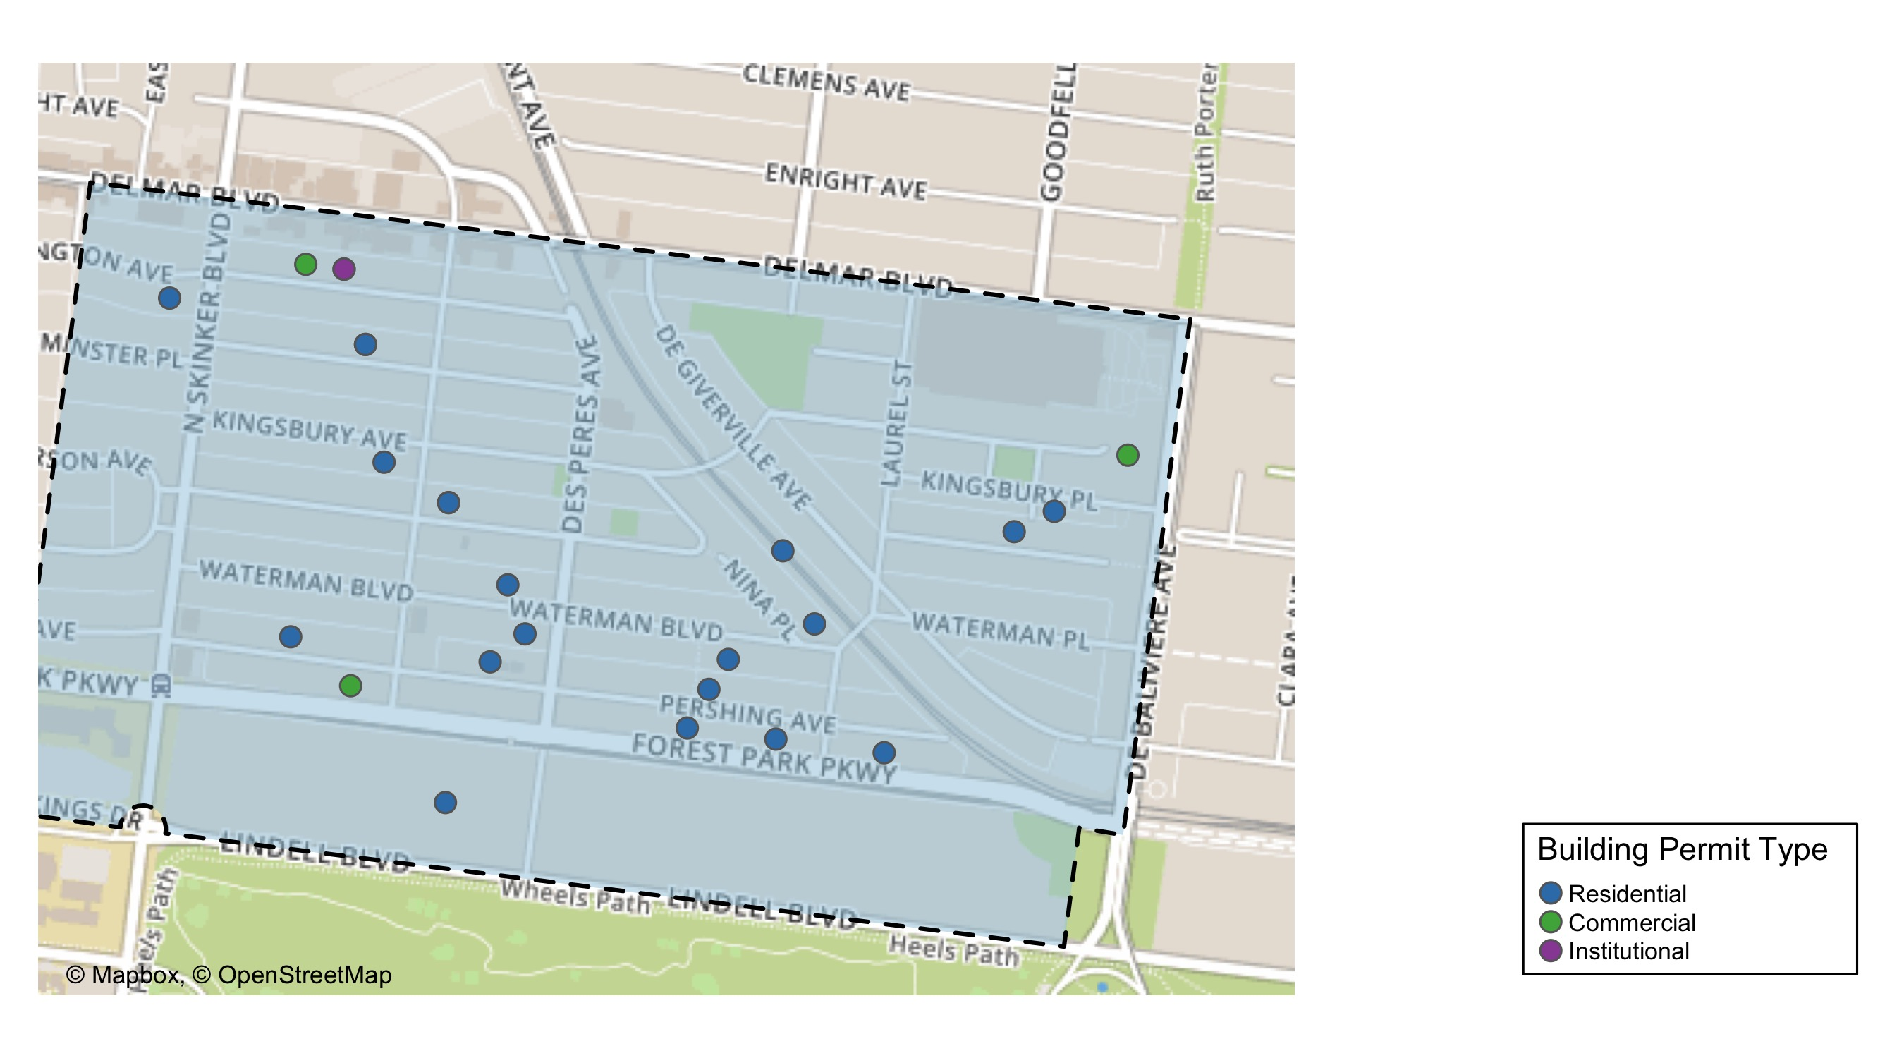
Skinker DeBaliviere

Slide 23
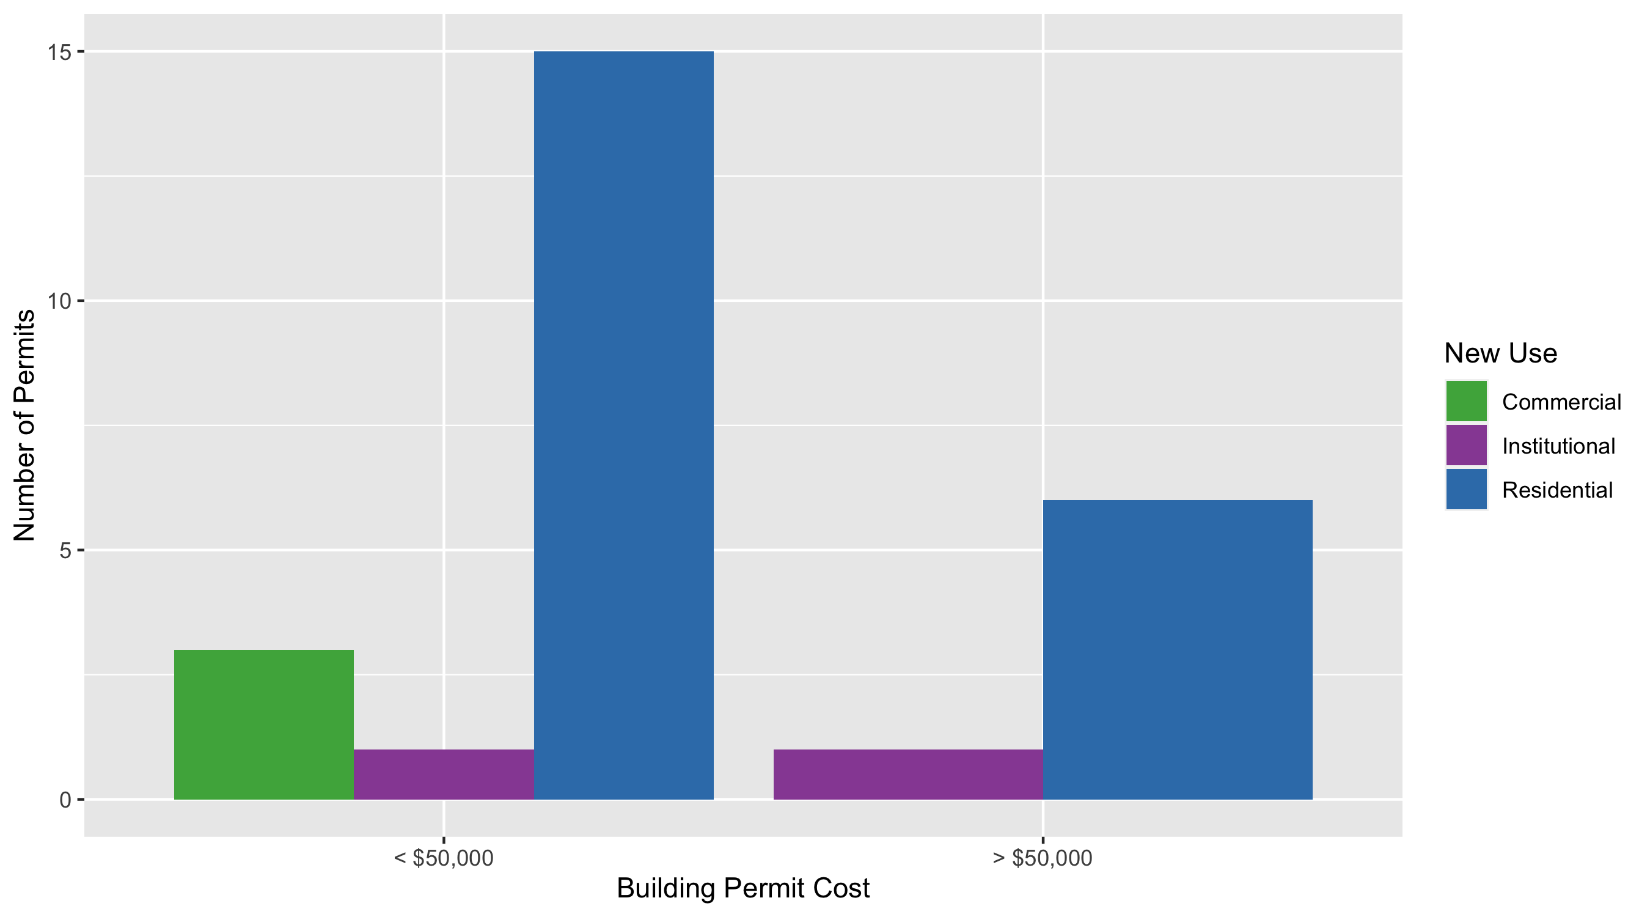
Skinker DeBaliviere Permit Use Breakdown

Slide 24
Skinker DeBaliviere Permit Breakdown
Quarter 4, 2020 | Quarter 4, 2020 | Quarter 4, 2020 | Quarter 4, 2020
Permit Use | Average Cost | # of Permits | Total Value of Permits
Commercial | 1e+04 | 3 | 3e+04
Industrial | 0e+00 | 0 | 0e+00
Institutional | 6e+05 | 2 | 1e+06
Residential | 3e+04 | 21 | 7e+05
Total | 7e+05 | 26 | 2e+06
Quarter 4, 2019 | Quarter 4, 2019 | Quarter 4, 2019 | Quarter 4, 2019
Permit Use | Average Cost | # of Permits | Total Value of Permits
Commercial | 17,650 | 2 | 4e+04
Industrial | 0 | 0 | 0e+00
Institutional | 0 | 0 | 0e+00
Residential | 19,114 | 22 | 4e+05
Total | 36,764 | 24 | 5e+05

Slide 25
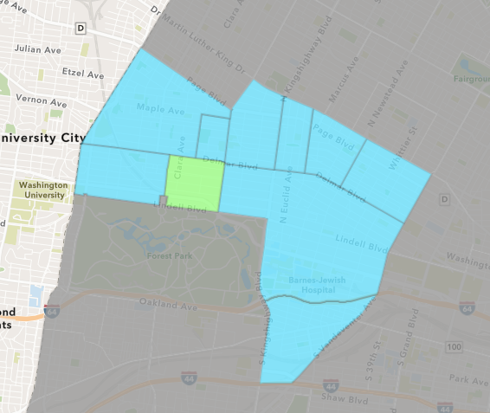
DeBaliviere Place
Quarter 4 , 2020 Neighborhood Cost Breakdown
Sum of Permits: $1,566,452
Mean: $97,903
Median: $54,950
Range: $1,200 - $437,500

Slide 26
DeBaliviere Place: Summary Notes
16 building permits in Quarter 4, 2020
6.67% change compared to Quarter 4, 2019 (15 total building permits)
$97,903: Average building permit cost in Quarter 4, 2020
133.97% change compared to Quarter 4, 2019 ($41,845)

Slide 27
DeBaliviere Place: Summary Notes
13 residential permits in Quarter 4, 2020
-13.33% change compared to Quarter 4, 2019 (15 total building permits)
$118,342: Average residential building permit cost in Quarter 4, 2020
182.81% change compared to Quarter 4, 2019 ($41,845)
0 industrial permits in Quarter 4, 2020
0.00% change compared to Quarter 4, 2019 (0 total building permits)
$0: Average industrial building permit cost in Quarter 4, 2020
0.00% change compared to Quarter 4, 2019 ($0)

Slide 28
DeBaliviere Place: Summary Notes
3 commercial permits in Quarter 4, 2020
Infinite change compared to Quarter 4, 2019 (0 total building permits)
$9,333: Average commercial building permit cost in Quarter 4, 2020
Infinite change compared to Quarter 4, 2019 ($0)
0 residential permits in Quarter 4, 2020
0.00% change compared to Quarter 4, 2019 (0 total building permits)
$0: Average institutional building permit cost in Quarter 4, 2020
0.00% change compared to Quarter 4, 2019 ($0)

Slide 29
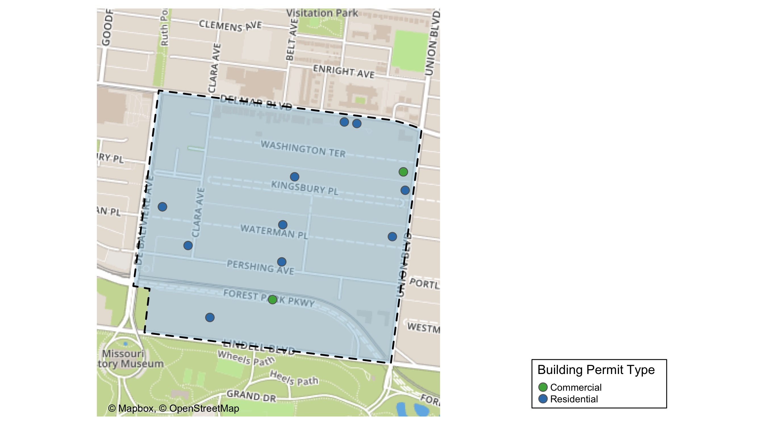
DeBaliviere Place

Slide 30
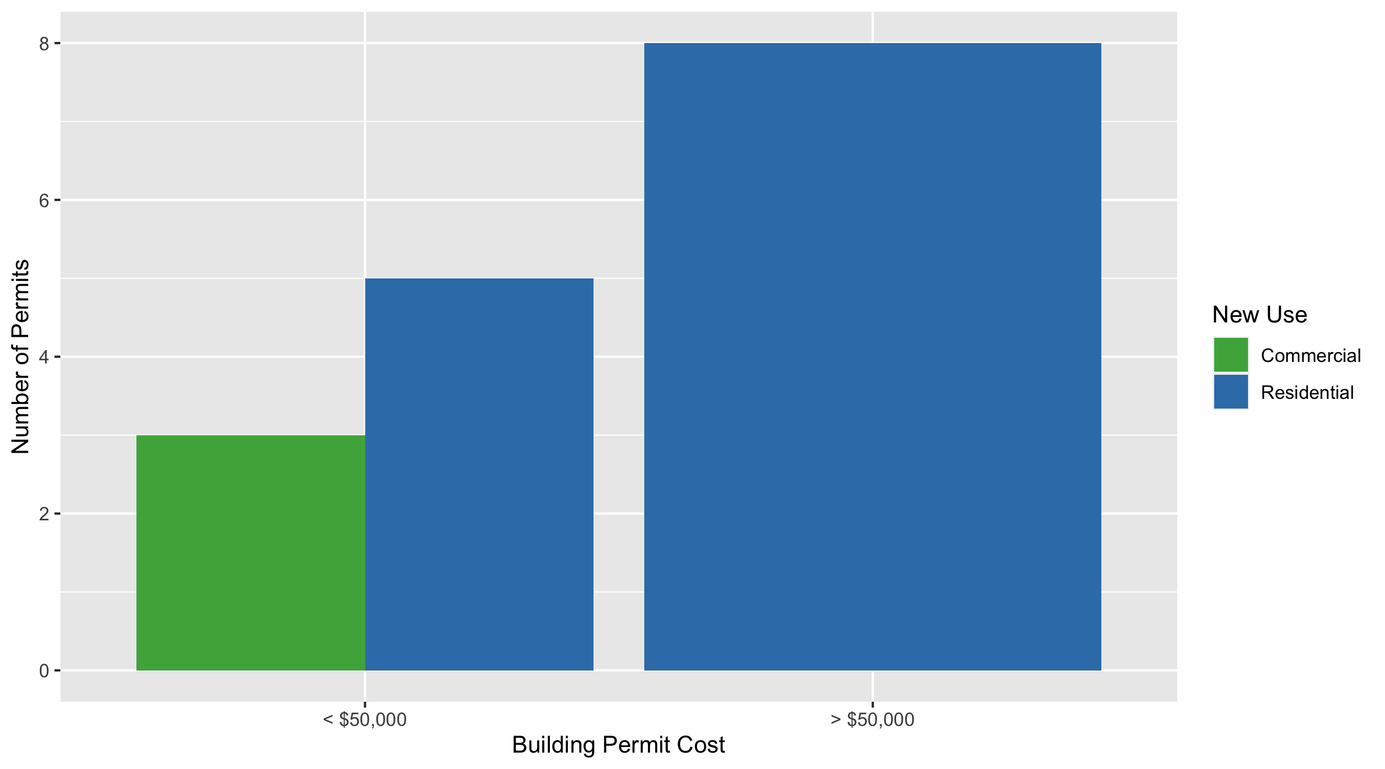
DeBaliviere Place Permit Use Breakdown

Slide 31
DeBaliviere Place Permit Breakdown
Quarter 4, 2020 | Quarter 4, 2020 | Quarter 4, 2020 | Quarter 4, 2020
Permit Use | Average Cost | # of Permits | Total Value of Permits
Commercial | 9e+03 | 3 | 3e+04
Industrial | 0e+00 | 0 | 0e+00
Institutional | 0e+00 | 0 | 0e+00
Residential | 1e+05 | 13 | 2e+06
Total | 1e+05 | 16 | 2e+06
Quarter 4, 2019 | Quarter 4, 2019 | Quarter 4, 2019 | Quarter 4, 2019
Permit Use | Average Cost | # of Permits | Total Value of Permits
Commercial | 0 | 0 | 0e+00
Industrial | 0 | 0 | 0e+00
Institutional | 0 | 0 | 0e+00
Residential | 41,845 | 15 | 6e+05
Total | 41,845 | 15 | 6e+05

Slide 32
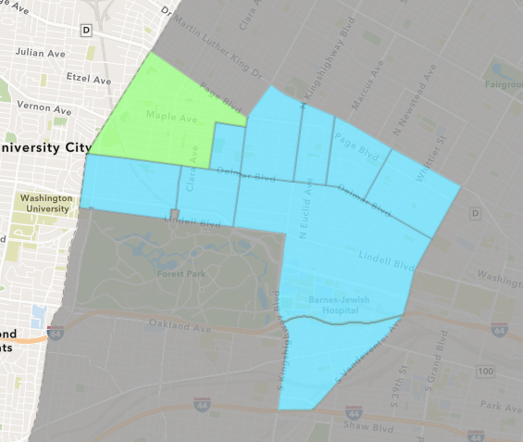
West End
Quarter 4 , 2020 Neighborhood Cost Breakdown
Sum of Permits: $2,219,407
Mean: $76,531
Median: $4,700
Range: $400 - $800,000

Slide 33
West End: Summary Notes
29 building permits in Quarter 4, 2020
52.63% change compared to Quarter 4, 2019 (19 total building permits)
$76,531: Average building permit cost in Quarter 4, 2020
-30.33% change compared to Quarter 4, 2019 ($109,844)

Slide 34
West End: Summary Notes
24 residential permits in Quarter 4, 2020
50.00% change compared to Quarter 4, 2019 (16 total building permits)
$83,117: Average residential building permit cost in Quarter 4, 2020
-17.94% change compared to Quarter 4, 2019 ($101,293)
0 industrial permits in Quarter 4, 2020
0.00% change compared to Quarter 4, 2019 (0 total building permits)
$0: Average industrial building permit cost in Quarter 4, 2020
0.00% change compared to Quarter 4, 2019 ($0)

Slide 35
West End: Summary Notes
5 commercial permits in Quarter 4, 2020
Infinite change compared to Quarter 4, 2019 (0 total building permits)
$44,920: Average commercial building permit cost in Quarter 4, 2020
Infinite change compared to Quarter 4, 2019 ($0)
0 residential permits in Quarter 4, 2020
-100.00% change compared to Quarter 4, 2019 (3 total building permits)
$0: Average institutional building permit cost in Quarter 4, 2020
-100.00% change compared to Quarter 4, 2019 ($0)

Slide 36
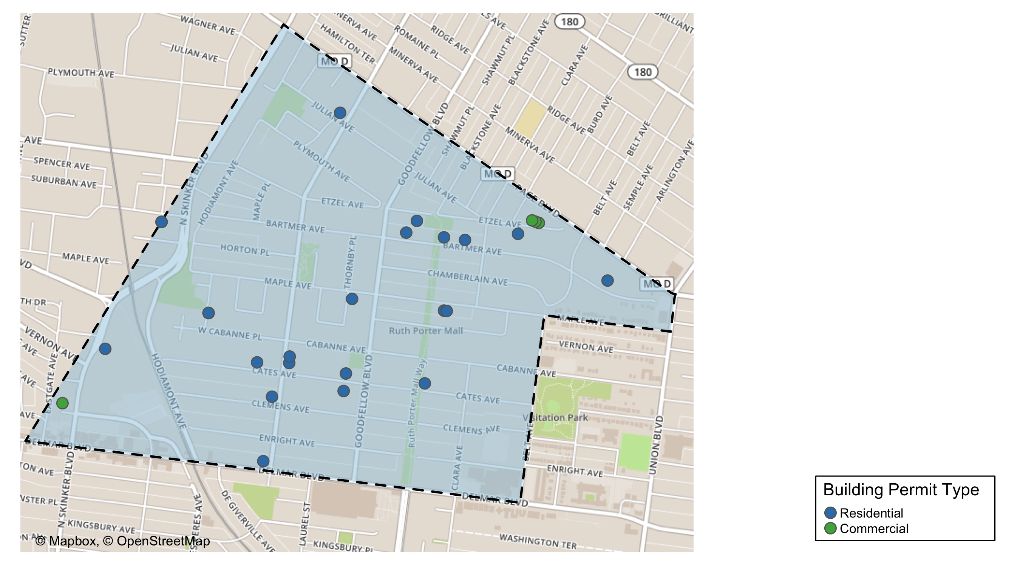
West End

Slide 37
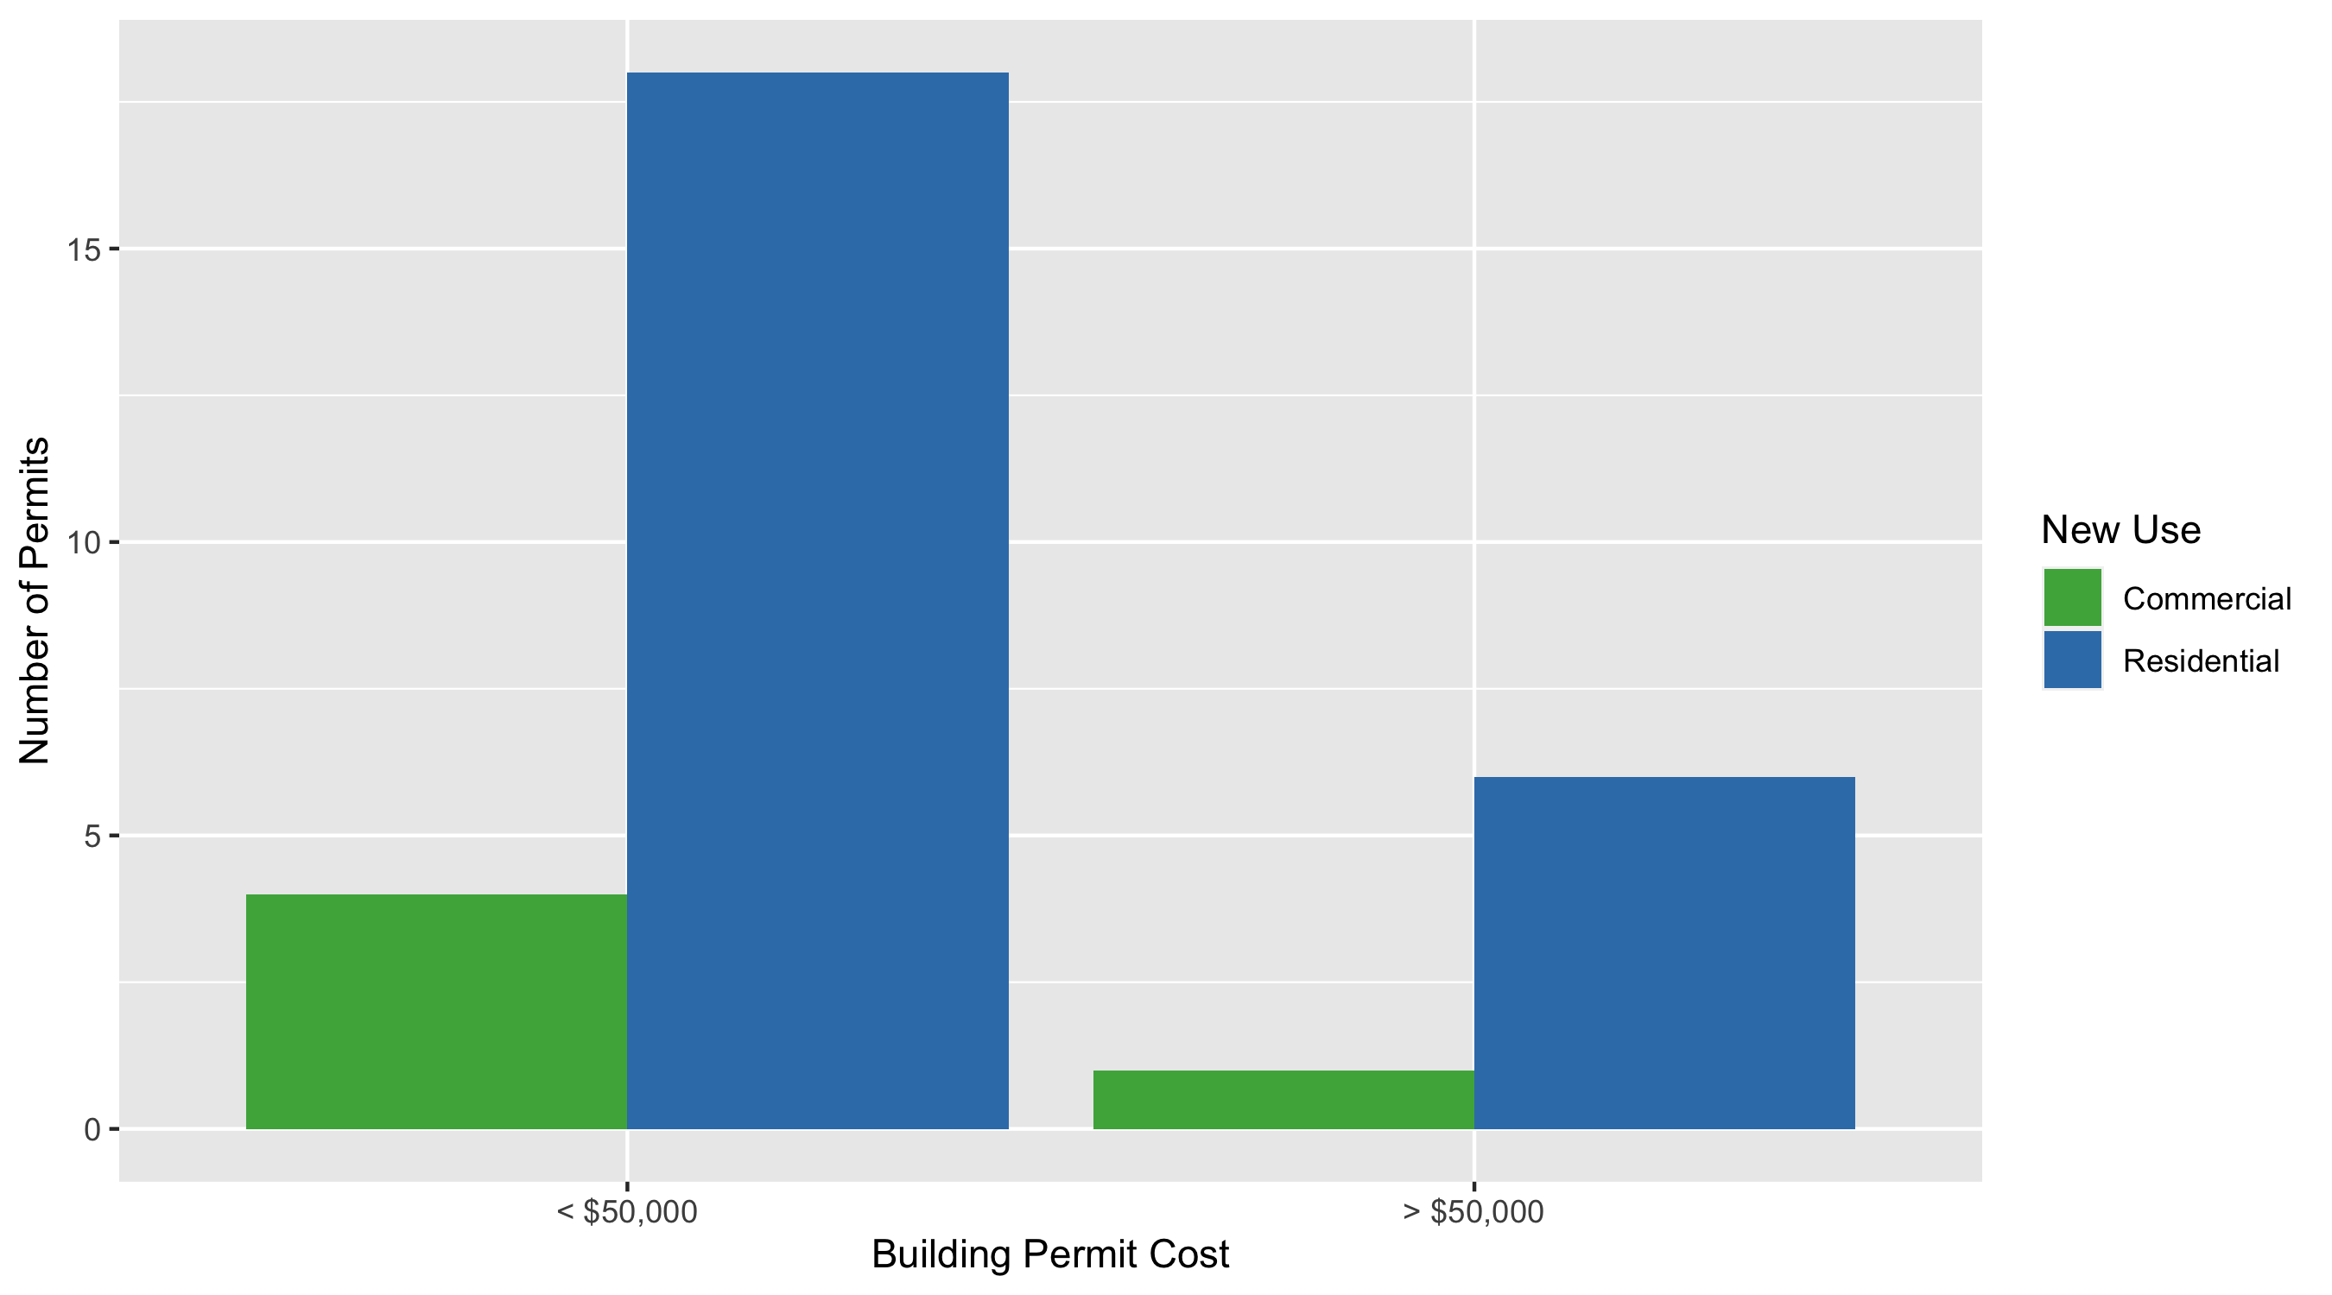
West End Permit Use Breakdown

Slide 38
West End Permit Breakdown
Quarter 4, 2020 | Quarter 4, 2020 | Quarter 4, 2020 | Quarter 4, 2020
Permit Use | Average Cost | # of Permits | Total Value of Permits
Commercial | 4e+04 | 5 | 2e+05
Industrial | 0e+00 | 0 | 0e+00
Institutional | 0e+00 | 0 | 0e+00
Residential | 8e+04 | 24 | 2e+06
Total | 1e+05 | 29 | 2e+06
Quarter 4, 2019 | Quarter 4, 2019 | Quarter 4, 2019 | Quarter 4, 2019
Permit Use | Average Cost | # of Permits | Total Value of Permits
Commercial | 0e+00 | 0 | 0e+00
Industrial | 0e+00 | 0 | 0e+00
Institutional | 2e+05 | 3 | 5e+05
Residential | 1e+05 | 16 | 2e+06
Total | 3e+05 | 19 | 2e+06

Slide 39
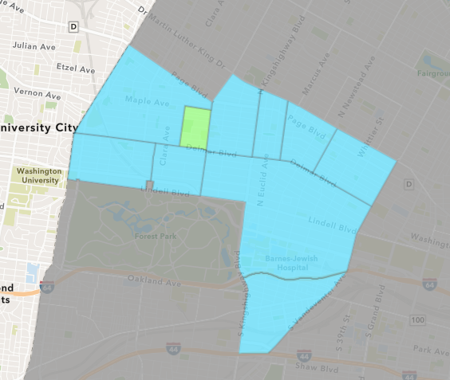
Visitation Park
Quarter 4 , 2020 Neighborhood Cost Breakdown
Sum of Permits: $10,274
Mean: $5,137
Median: $5,137
Range: $2,500 - $7,774

Slide 40
Visitation Park: Summary Notes
2 building permits in Quarter 4, 2020
Infinite change compared to Quarter 4, 2019 (0 total building permits)
$5,137: Average building permit cost in Quarter 4, 2020
Infinite change compared to Quarter 4, 2019 ($0)

Slide 41
Visitation Park: Summary Notes
2 residential permits in Quarter 4, 2020
Infinite change compared to Quarter 4, 2019 (0 total building permits)
$5,137: Average residential building permit cost in Quarter 4, 2020
Infinite change compared to Quarter 4, 2019 ($0)
0 industrial permits in Quarter 4, 2020
0.00% change compared to Quarter 4, 2019 (0 total building permits)
$0: Average industrial building permit cost in Quarter 4, 2020
0.00% change compared to Quarter 4, 2019 ($0)

Slide 42
Visitation Park: Summary Notes
0 commercial permits in Quarter 4, 2020
0.00% change compared to Quarter 4, 2019 (0 total building permits)
$0: Average commercial building permit cost in Quarter 4, 2020
0.00% change compared to Quarter 4, 2019 ($0)
0 residential permits in Quarter 4, 2020
0.00% change compared to Quarter 4, 2019 (0 total building permits)
$0: Average institutional building permit cost in Quarter 4, 2020
0.00% change compared to Quarter 4, 2019 ($0)

Slide 43
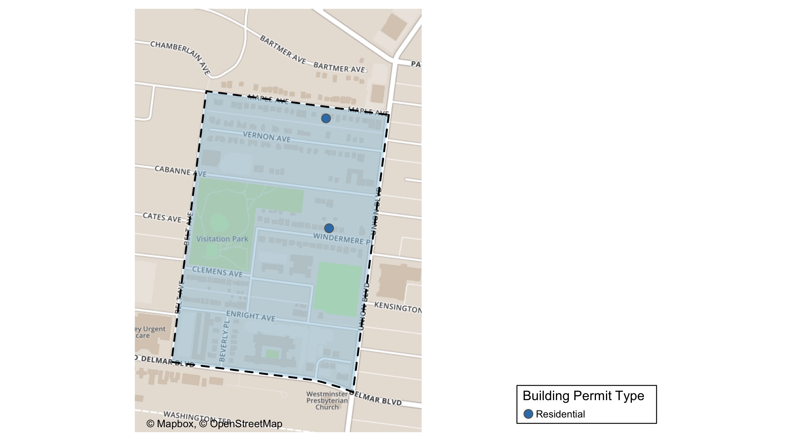
Visitation Park

Slide 44
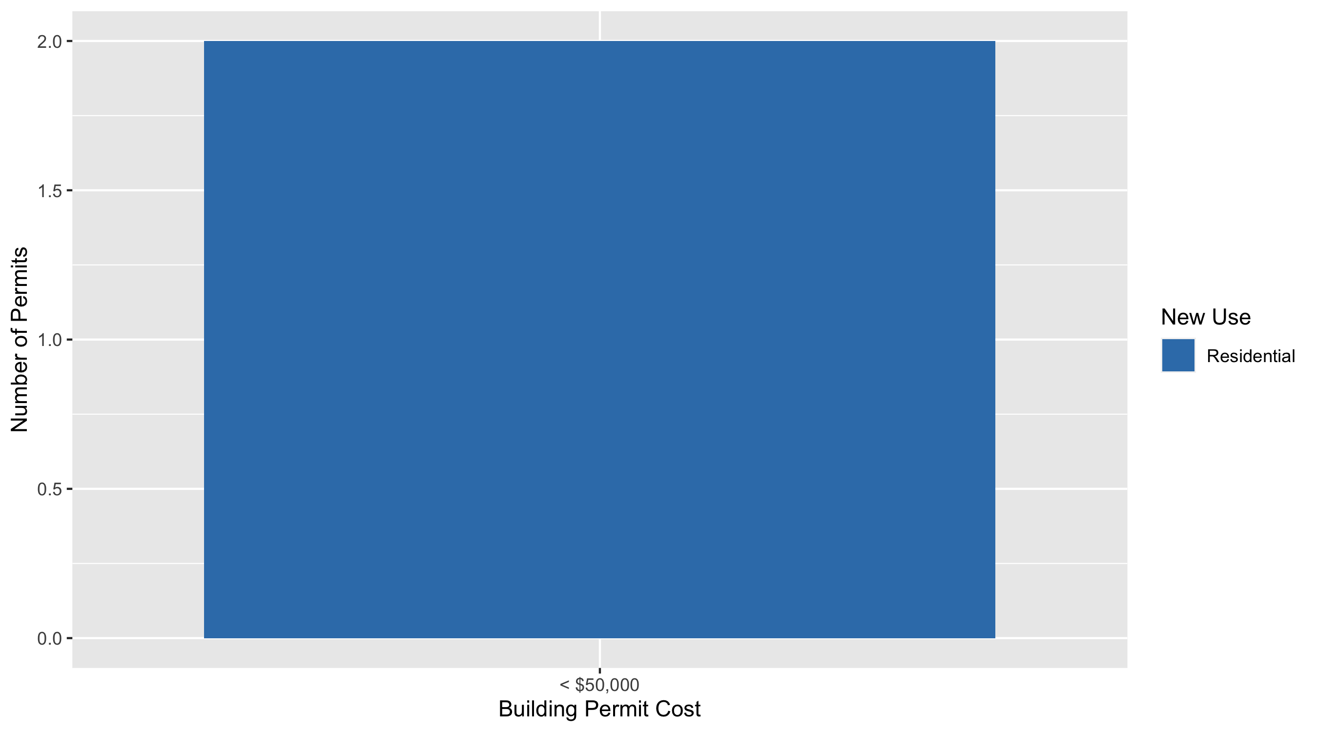
Visitation Park Permit Use Breakdown

Slide 45
Visitation Park Permit Breakdown
Quarter 4, 2020 | Quarter 4, 2020 | Quarter 4, 2020 | Quarter 4, 2020
Permit Use | Average Cost | # of Permits | Total Value of Permits
Commercial | 0 | 0 | 0
Industrial | 0 | 0 | 0
Institutional | 0 | 0 | 0
Residential | 5,137 | 2 | 10,274
Total | 5,137 | 2 | 10,274
Quarter 4, 2019 | Quarter 4, 2019 | Quarter 4, 2019 | Quarter 4, 2019
Permit Use | Average Cost | # of Permits | Total Value of Permits
Commercial | 0 | 0 | 0
Industrial | 0 | 0 | 0
Institutional | 0 | 0 | 0
Residential | 0 | 0 | 0
Total | 0 | 0 | 0

Slide 46
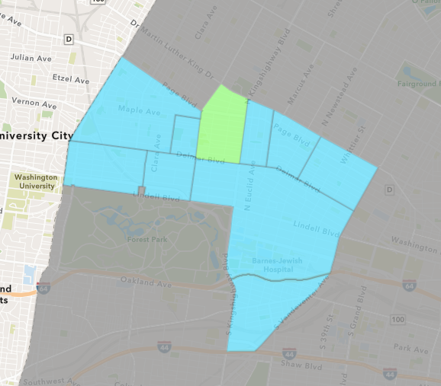
Academy
Quarter 4 , 2020 Neighborhood Cost Breakdown
Sum of Permits: $321,599
Mean: $22,971
Median: $3,500
Range: $300 - $200,000

Slide 47
Academy: Summary Notes
14 building permits in Quarter 4, 2020
133.33% change compared to Quarter 4, 2019 (6 total building permits)
$22,971: Average building permit cost in Quarter 4, 2020
-47.11% change compared to Quarter 4, 2019 ($43,434)

Slide 48
Academy: Summary Notes
12 residential permits in Quarter 4, 2020
100.00% change compared to Quarter 4, 2019 (6 total building permits)
$25,092: Average residential building permit cost in Quarter 4, 2020
-42.23% change compared to Quarter 4, 2019 ($43,434)
0 industrial permits in Quarter 4, 2020
0.00% change compared to Quarter 4, 2019 (0 total building permits)
$0: Average industrial building permit cost in Quarter 4, 2020
0.00% change compared to Quarter 4, 2019 ($0)

Slide 49
Academy: Summary Notes
1 commercial permits in Quarter 4, 2020
Infinite change compared to Quarter 4, 2019 (0 total building permits)
$15,000: Average commercial building permit cost in Quarter 4, 2020
Infinite change compared to Quarter 4, 2019 ($0)
1 residential permits in Quarter 4, 2020
Infinite change compared to Quarter 4, 2019 (0 total building permits)
$5,500: Average institutional building permit cost in Quarter 4, 2020
Infinite change compared to Quarter 4, 2019 ($0)

Slide 50
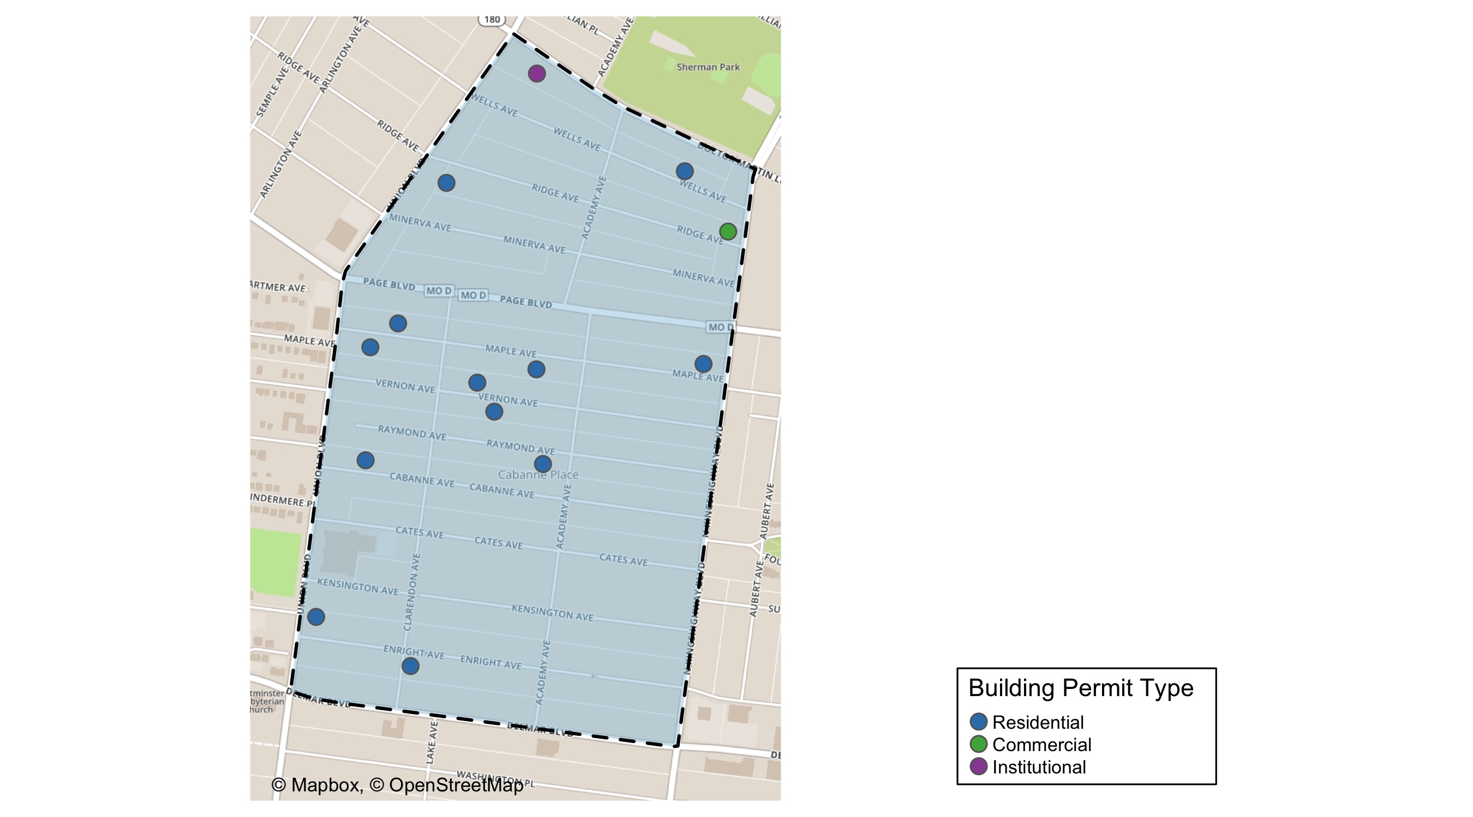
Academy

Slide 51
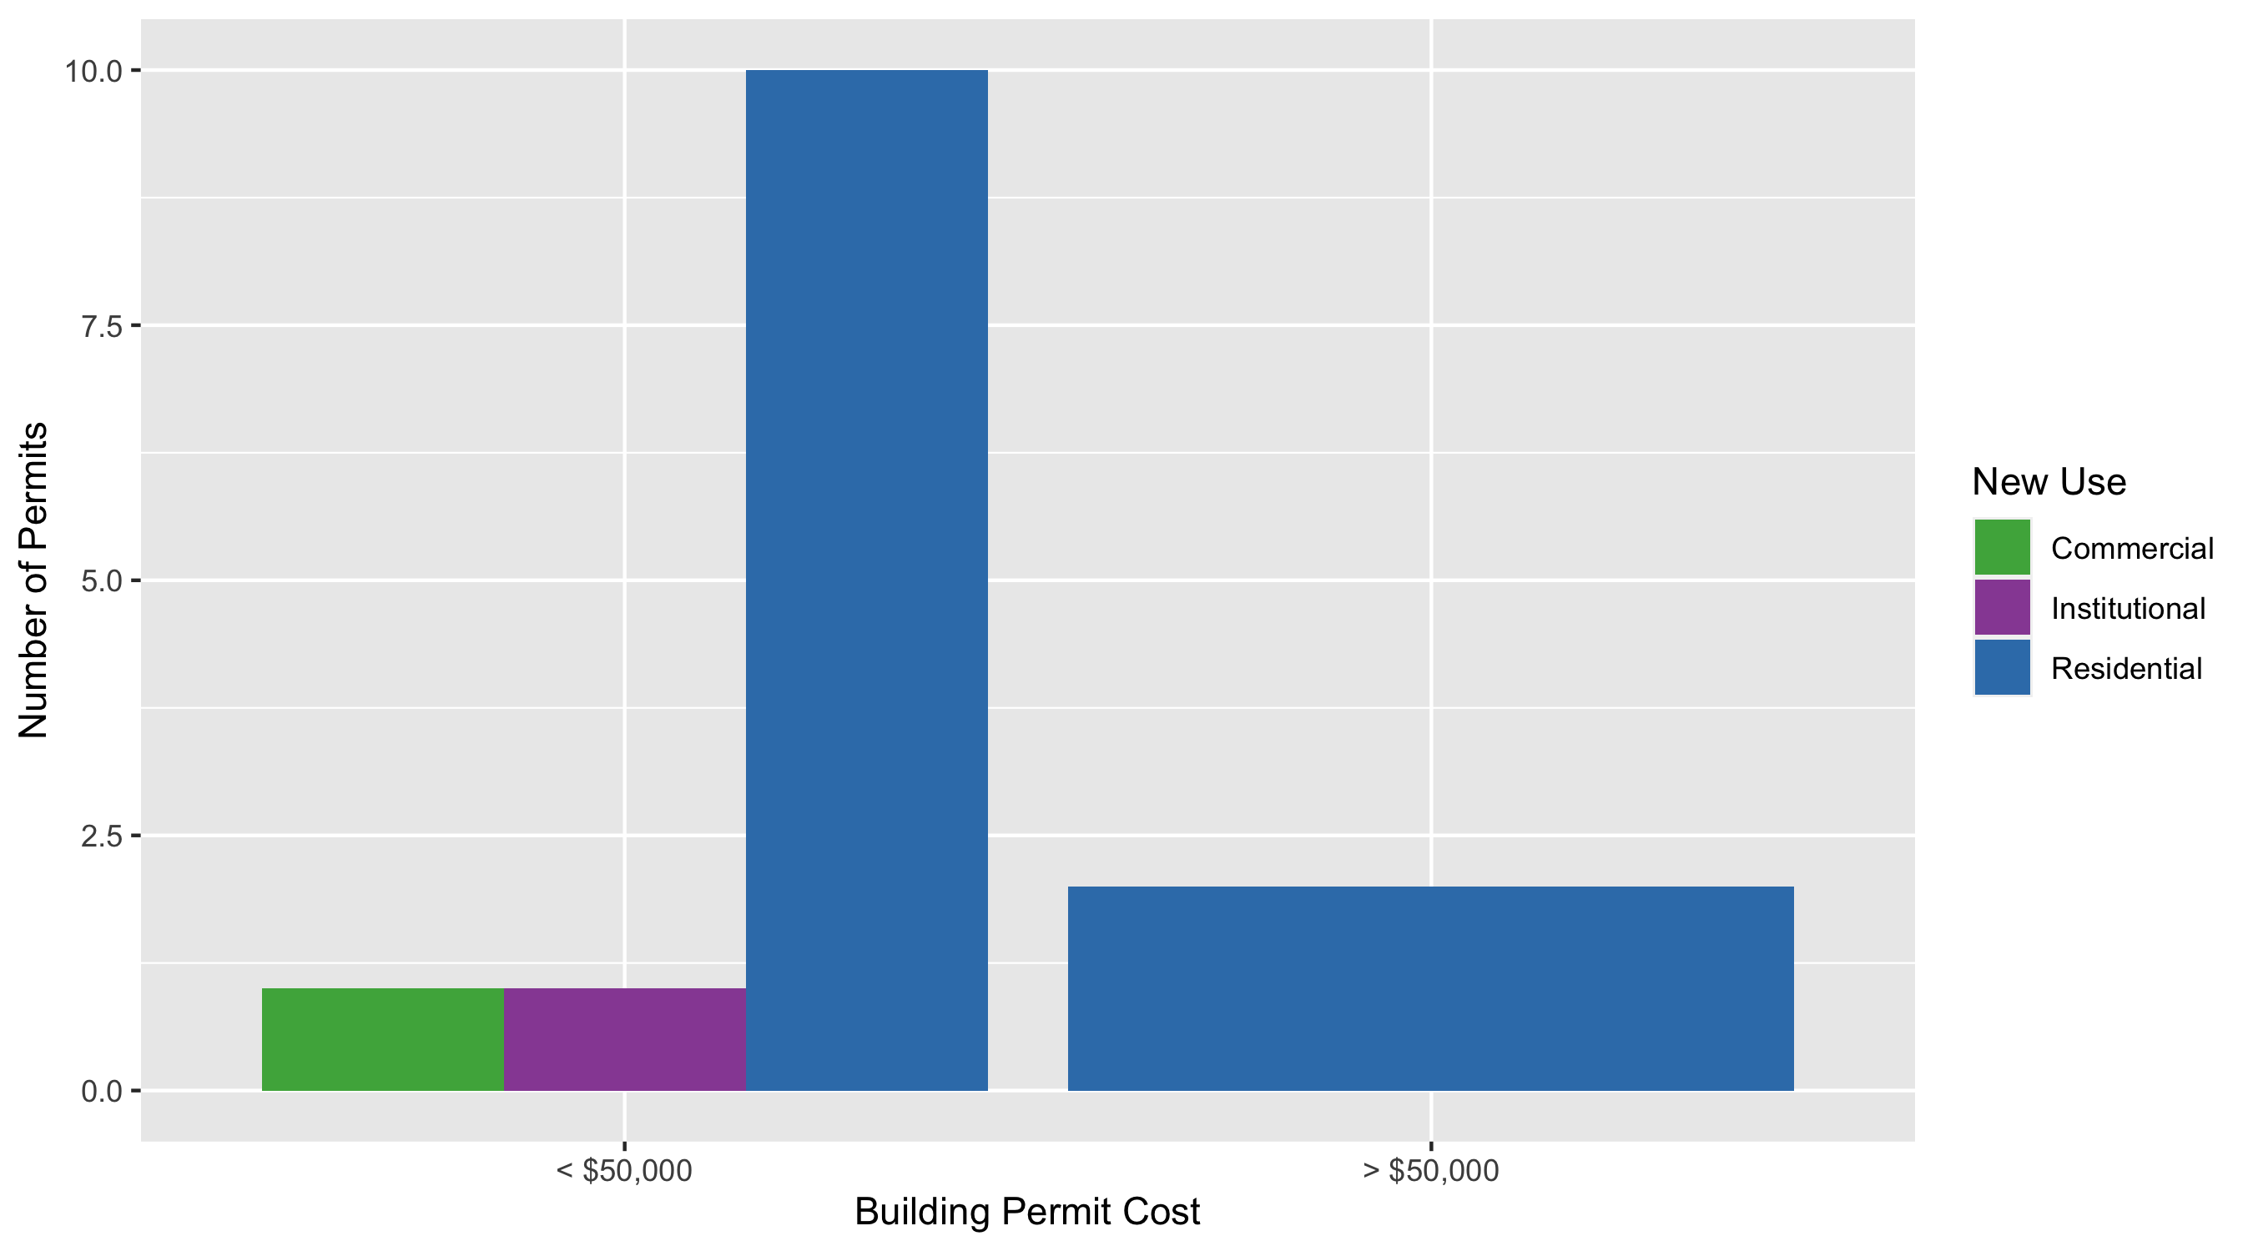
Academy Permit Use Breakdown

Slide 52
Academy Permit Breakdown
Quarter 4, 2020 | Quarter 4, 2020 | Quarter 4, 2020 | Quarter 4, 2020
Permit Use | Average Cost | # of Permits | Total Value of Permits
Commercial | 15,000 | 1 | 2e+04
Industrial | 0 | 0 | 0e+00
Institutional | 5,500 | 1 | 6e+03
Residential | 25,092 | 12 | 3e+05
Total | 45,592 | 14 | 3e+05
Quarter 4, 2019 | Quarter 4, 2019 | Quarter 4, 2019 | Quarter 4, 2019
Permit Use | Average Cost | # of Permits | Total Value of Permits
Commercial | 0 | 0 | 0e+00
Industrial | 0 | 0 | 0e+00
Institutional | 0 | 0 | 0e+00
Residential | 43,434 | 6 | 3e+05
Total | 43,434 | 6 | 3e+05

Slide 53
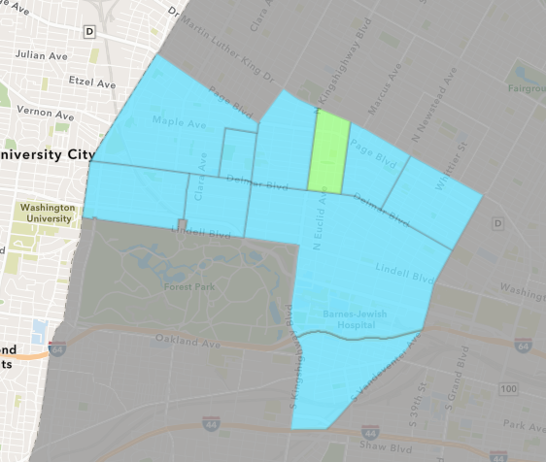
Fountain Park
Quarter 4 , 2020 Neighborhood Cost Breakdown
Sum of Permits: $30,000
Mean: $30,000
Median: $30,000
Range: $30,000 - $30,000

Slide 54
Fountain Park: Summary Notes
1 building permits in Quarter 4, 2020
-66.67% change compared to Quarter 4, 2019 (3 total building permits)
$30,000: Average building permit cost in Quarter 4, 2020
-30.77% change compared to Quarter 4, 2019 ($43,333)

Slide 55
Fountain Park: Summary Notes
0 residential permits in Quarter 4, 2020
-100.00% change compared to Quarter 4, 2019 (2 total building permits)
$0: Average residential building permit cost in Quarter 4, 2020
-100.00% change compared to Quarter 4, 2019 ($50,000)
0 industrial permits in Quarter 4, 2020
0.00% change compared to Quarter 4, 2019 (0 total building permits)
$0: Average industrial building permit cost in Quarter 4, 2020
0.00% change compared to Quarter 4, 2019 ($0)

Slide 56
Fountain Park: Summary Notes
1 commercial permits in Quarter 4, 2020
0.00% change compared to Quarter 4, 2019 (1 total building permits)
$30,000: Average commercial building permit cost in Quarter 4, 2020
0.00% change compared to Quarter 4, 2019 ($30,000)
0 residential permits in Quarter 4, 2020
0.00% change compared to Quarter 4, 2019 (0 total building permits)
$0: Average institutional building permit cost in Quarter 4, 2020
0.00% change compared to Quarter 4, 2019 ($0)

Slide 57
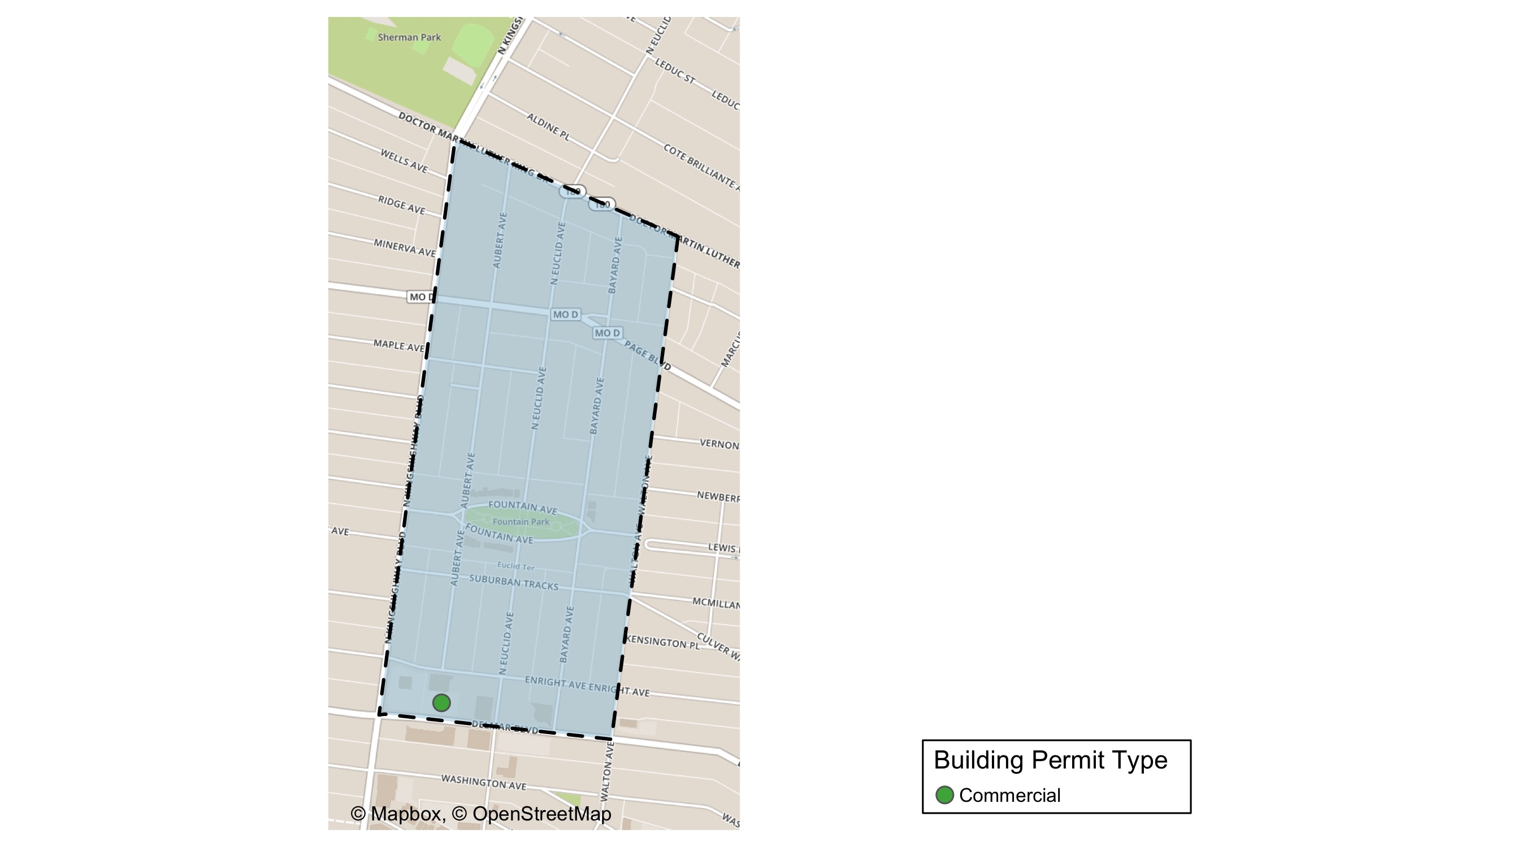
Fountain Park

Slide 58
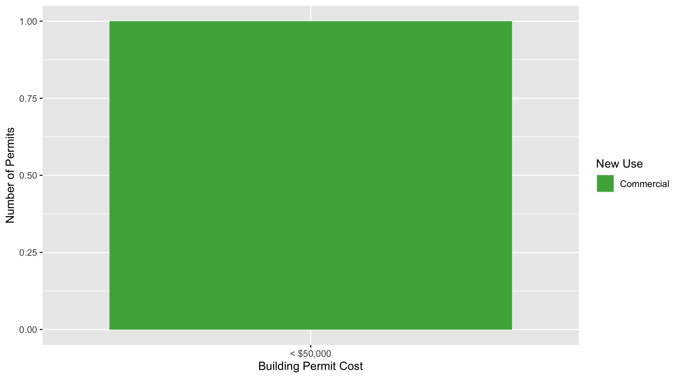
Fountain Park Permit Use Breakdown

Slide 59
Fountain Park Permit Breakdown
Quarter 4, 2020 | Quarter 4, 2020 | Quarter 4, 2020 | Quarter 4, 2020
Permit Use | Average Cost | # of Permits | Total Value of Permits
Commercial | 30,000 | 1 | 30,000
Industrial | 0 | 0 | 0
Institutional | 0 | 0 | 0
Residential | 0 | 0 | 0
Total | 30,000 | 1 | 30,000
Quarter 4, 2019 | Quarter 4, 2019 | Quarter 4, 2019 | Quarter 4, 2019
Permit Use | Average Cost | # of Permits | Total Value of Permits
Commercial | 30,000 | 1 | 3e+04
Industrial | 0 | 0 | 0e+00
Institutional | 0 | 0 | 0e+00
Residential | 50,000 | 2 | 1e+05
Total | 80,000 | 3 | 1e+05

Slide 60
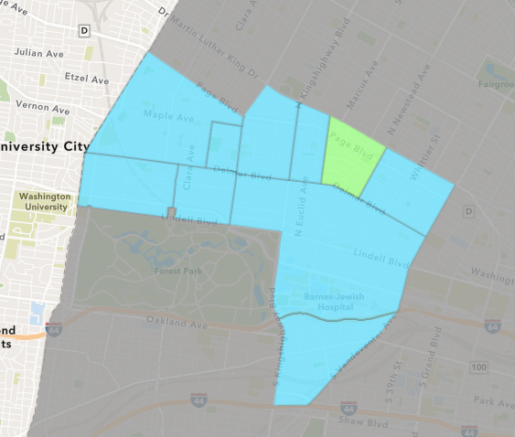
Lewis Place
Quarter 4 , 2020 Neighborhood Cost Breakdown
Sum of Permits: $36,463
Mean: $6,077
Median: $4,162
Range: $1,000 - $17,640

Slide 61
Lewis Place: Summary Notes
6 building permits in Quarter 4, 2020
200.00% change compared to Quarter 4, 2019 (2 total building permits)
$6,077: Average building permit cost in Quarter 4, 2020
-78.49% change compared to Quarter 4, 2019 ($28,250)

Slide 62
Lewis Place: Summary Notes
6 residential permits in Quarter 4, 2020
200.00% change compared to Quarter 4, 2019 (2 total building permits)
$6,077: Average residential building permit cost in Quarter 4, 2020
-78.49% change compared to Quarter 4, 2019 ($28,250)
0 industrial permits in Quarter 4, 2020
0.00% change compared to Quarter 4, 2019 (0 total building permits)
$0: Average industrial building permit cost in Quarter 4, 2020
0.00% change compared to Quarter 4, 2019 ($0)

Slide 63
Lewis Place: Summary Notes
0 commercial permits in Quarter 4, 2020
0.00% change compared to Quarter 4, 2019 (0 total building permits)
$0: Average commercial building permit cost in Quarter 4, 2020
0.00% change compared to Quarter 4, 2019 ($0)
0 residential permits in Quarter 4, 2020
0.00% change compared to Quarter 4, 2019 (0 total building permits)
$0: Average institutional building permit cost in Quarter 4, 2020
0.00% change compared to Quarter 4, 2019 ($0)

Slide 64
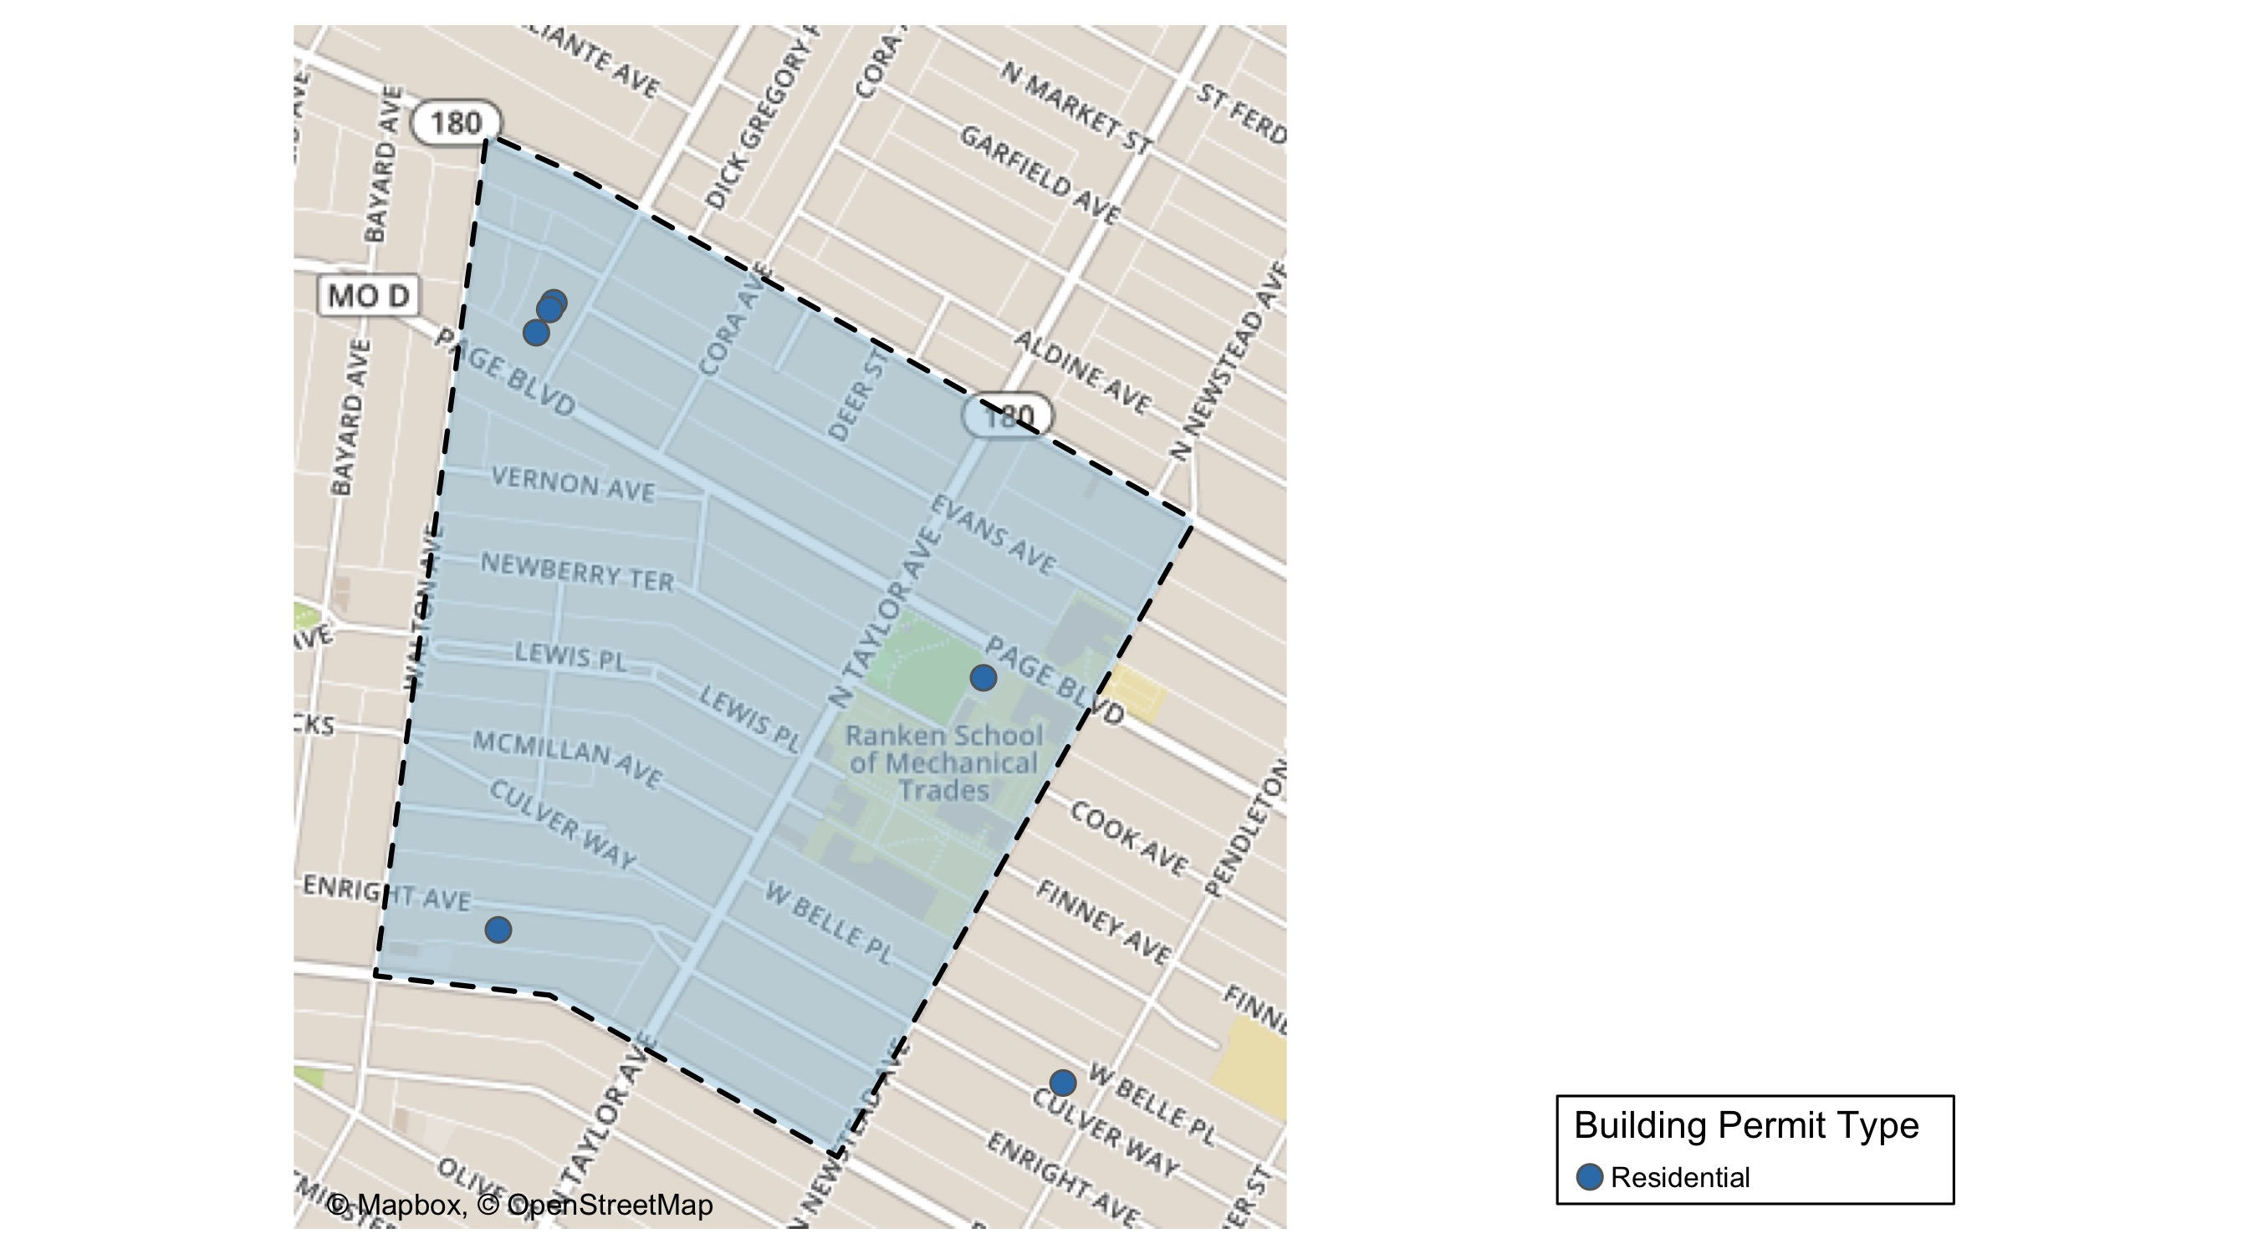
Lewis Place

Slide 65
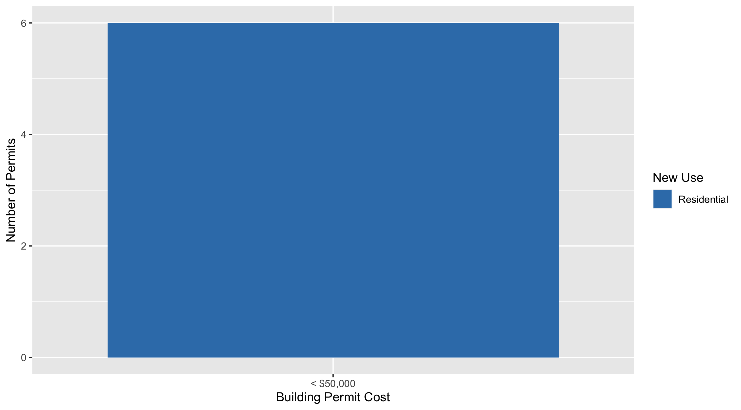
Lewis Place Permit Use Breakdown

Slide 66
Lewis Place Permit Breakdown
Quarter 4, 2020 | Quarter 4, 2020 | Quarter 4, 2020 | Quarter 4, 2020
Permit Use | Average Cost | # of Permits | Total Value of Permits
Commercial | 0 | 0 | 0
Industrial | 0 | 0 | 0
Institutional | 0 | 0 | 0
Residential | 6,077 | 6 | 36,463
Total | 6,077 | 6 | 36,463
Quarter 4, 2019 | Quarter 4, 2019 | Quarter 4, 2019 | Quarter 4, 2019
Permit Use | Average Cost | # of Permits | Total Value of Permits
Commercial | 0 | 0 | 0
Industrial | 0 | 0 | 0
Institutional | 0 | 0 | 0
Residential | 28,250 | 2 | 56,500
Total | 28,250 | 2 | 56,500

Slide 67
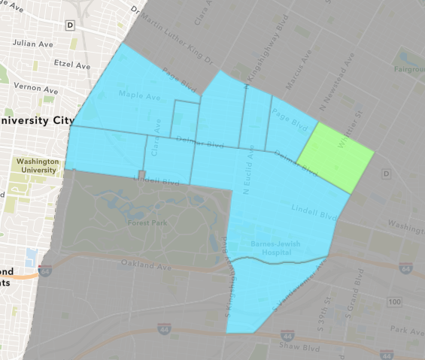
Vandeventer
Quarter 4 , 2020 Neighborhood Cost Breakdown
Sum of Permits: $153,323
Mean: $25,554
Median: $23,150
Range: $5,023 - $56,000

Slide 68
Vandeventer: Summary Notes
6 building permits in Quarter 4, 2020
20.00% change compared to Quarter 4, 2019 (5 total building permits)
$25,554: Average building permit cost in Quarter 4, 2020
-36.12% change compared to Quarter 4, 2019 ($40,000)

Slide 69
Vandeventer: Summary Notes
4 residential permits in Quarter 4, 2020
0.00% change compared to Quarter 4, 2019 (4 total building permits)
$23,075: Average residential building permit cost in Quarter 4, 2020
-51.42% change compared to Quarter 4, 2019 ($47,500)
0 industrial permits in Quarter 4, 2020
0.00% change compared to Quarter 4, 2019 (0 total building permits)
$0: Average industrial building permit cost in Quarter 4, 2020
0.00% change compared to Quarter 4, 2019 ($0)

Slide 70
Vandeventer: Summary Notes
0 commercial permits in Quarter 4, 2020
-100.00% change compared to Quarter 4, 2019 (1 total building permits)
$0: Average commercial building permit cost in Quarter 4, 2020
-100.00% change compared to Quarter 4, 2019 ($10,000)
2 residential permits in Quarter 4, 2020
Infinite change compared to Quarter 4, 2019 (0 total building permits)
$30,512: Average institutional building permit cost in Quarter 4, 2020
Infinite change compared to Quarter 4, 2019 ($0)

Slide 71
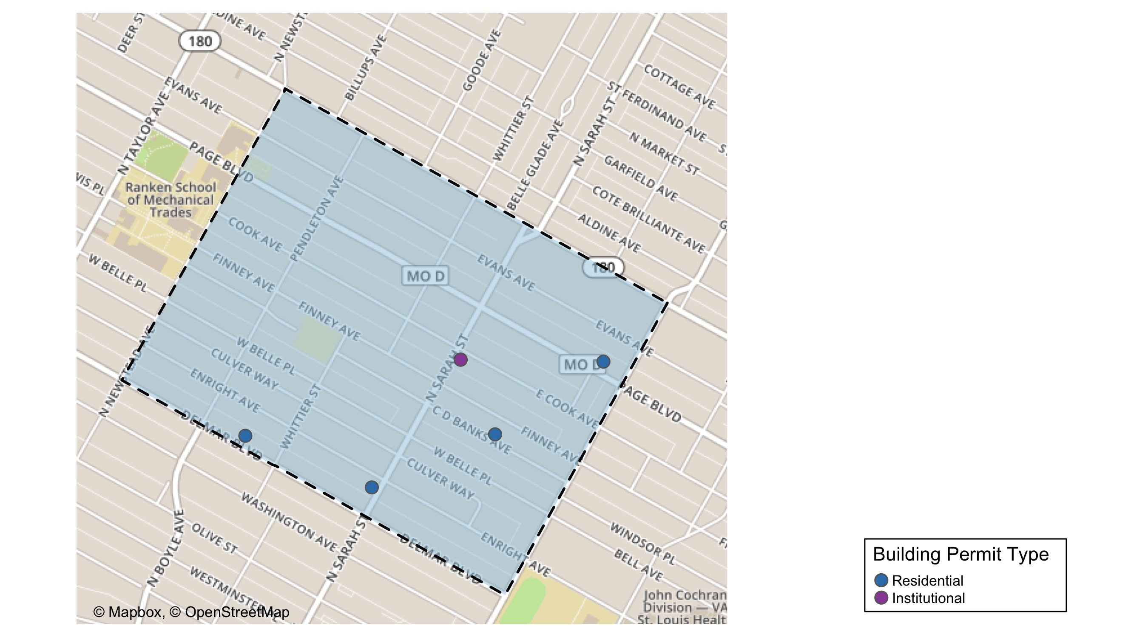
Vandeventer

Slide 72
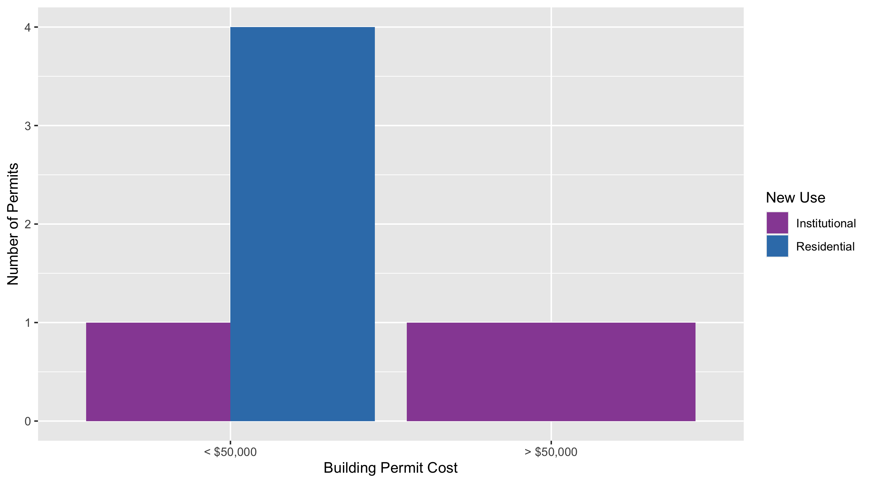
Vandeventer Permit Use Breakdown

Slide 73
Vandeventer Permit Breakdown
Quarter 4, 2020 | Quarter 4, 2020 | Quarter 4, 2020 | Quarter 4, 2020
Permit Use | Average Cost | # of Permits | Total Value of Permits
Commercial | 0 | 0 | 0e+00
Industrial | 0 | 0 | 0e+00
Institutional | 30,512 | 2 | 6e+04
Residential | 23,075 | 4 | 9e+04
Total | 53,586 | 6 | 2e+05
Quarter 4, 2019 | Quarter 4, 2019 | Quarter 4, 2019 | Quarter 4, 2019
Permit Use | Average Cost | # of Permits | Total Value of Permits
Commercial | 10,000 | 1 | 1e+04
Industrial | 0 | 0 | 0e+00
Institutional | 0 | 0 | 0e+00
Residential | 47,500 | 4 | 2e+05
Total | 57,500 | 5 | 2e+05

Slide 74
Additional Notes
Data retreived from https://www.stlouis-mo.gov/data/
Building permits with a cost of $0 were dropped
Building permits that were cancelled were dropped
Infinite change indicates 0 permits in the current or previous time period/comparison month so there was a overall increase or decrease

